Slide 1
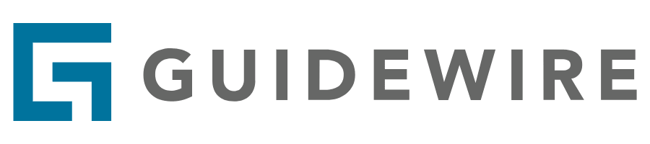
InsuranceSuite 10 Fundamentals
Digital Platform

Slide 2
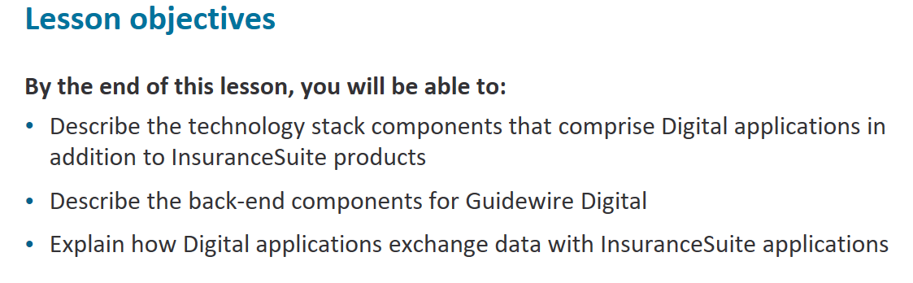

Slide 3
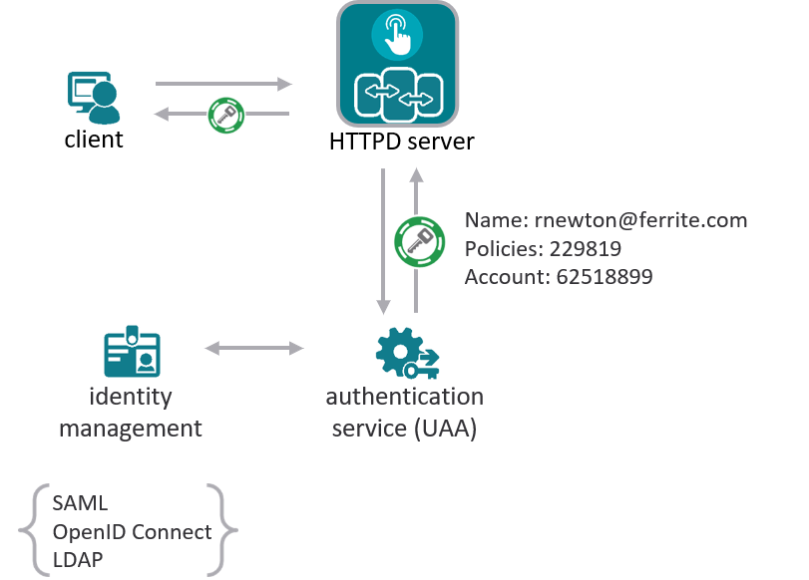
Notes:
Digital products are built on an architecture that includes the backend and frontend components.
A HTTPD server is required to host the application front-end code and service client requests.
Digital applications that require authentication are equipped with User Account and Authentication (or UAA for short) that provides the authorization service and is available on the Cloud Foundry platform.
Cloud Foundry UAA is a third-party multi-tenant identity management service, whose primary role is as an OAuth2 provider, issuing access tokens that authorize users to access InsuranceSuite resources. In the base application, UAA includes its own identity management service but this can be replaced with other identity management
providers (Google, Facebook, salesforce, Auth0, Windows Active Directory) that can use SAML, OpenID connect or LDAP, for example.
A range of technologies comprise the front end:
The base application is built on a combination of angular js and framework agnostic JavaScript services.
Angular UI router on the front end to bring rich functionality to the client side.
Note that the external authentication service is optional

Slide 4
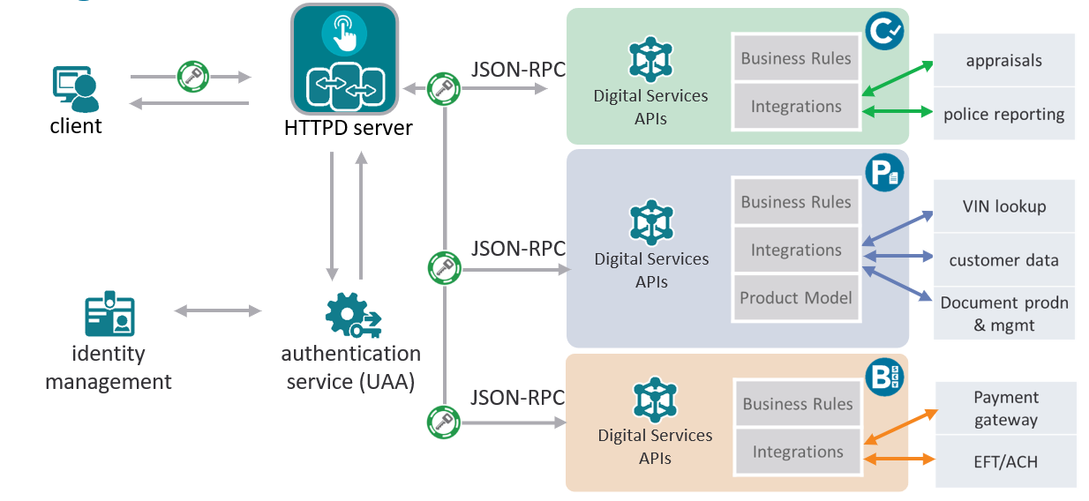
Notes:
A range of technologies comprise the front end:
• The base application is built on a combination of AngularJS and framework agnostic JavaScript services.
• Angular UI router on the front end to bring rich functionality to the client side.
• Note that the external authentication service is optional
The back-end digital services architecture is built using Gosu, and re-uses core Insurance Suite functionality, business rules and third party integrations that are exposed
on the Digital services layer. Next, you will learn how Digital services surface Insurance Suite data and expose it to Digital applications.

Slide 5


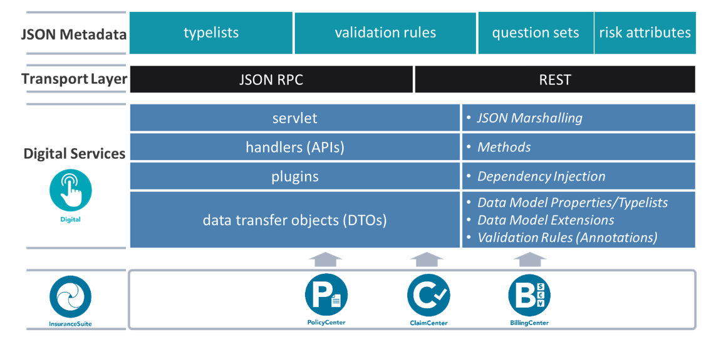
Notes:
The digital back end application that can be split into layers for:
• JSON Metadata
• Typelists, validation rules, question sets and risk attributes are retrieved from InsuranceSuite applications at build-time and packaged for consumption on the user interface
• Transport Layer
• Digital services predominantly use JSON-RPC services, however for Guidewire Salesforce applications RESTful services are also employed
• Digital Services
• Use JsonRPC servlet for bidirectional data transfer and JSON serialization and deserialization
Capabilities have handler entry points that delegate specific functionality to plugins. Data transfer object facilitate data interchange by modelling InsuranceSuite data that will be exposed to digital applications

Slide 6
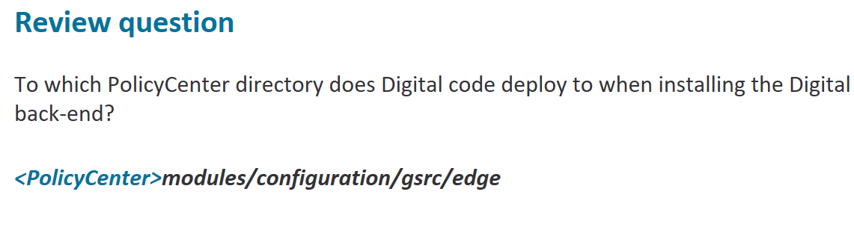

Slide 7
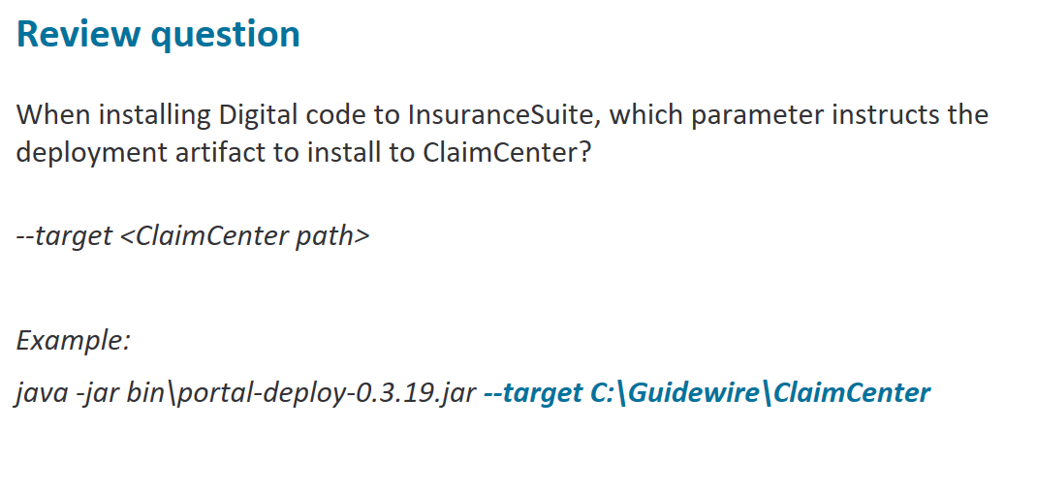

Slide 8
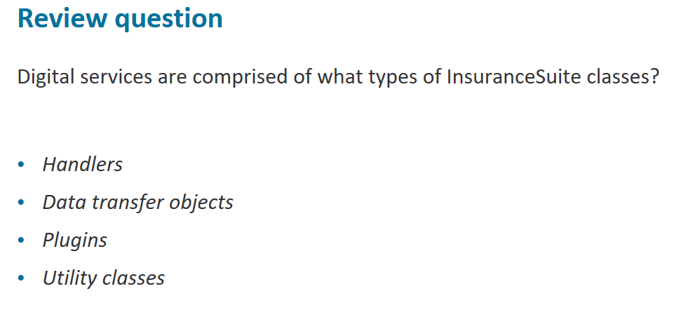

Slide 9
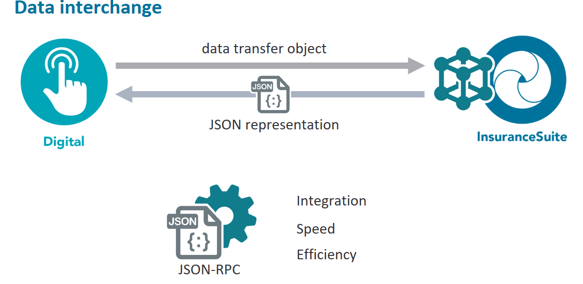
Notes:
Now, you will learn how data is exchanged between InsuranceSuite applications and Guidewire Digital products. JSON-RPC is a remote procedure call protocol, similar to XML-RPC, that facilitates data interchange using JSON.
JSON-RPC is used for its ease of integration, speed, and efficiency. JSON has lower overhead than XML, integrates easily with mobile web applications, and has tool support in many languages.

Slide 10
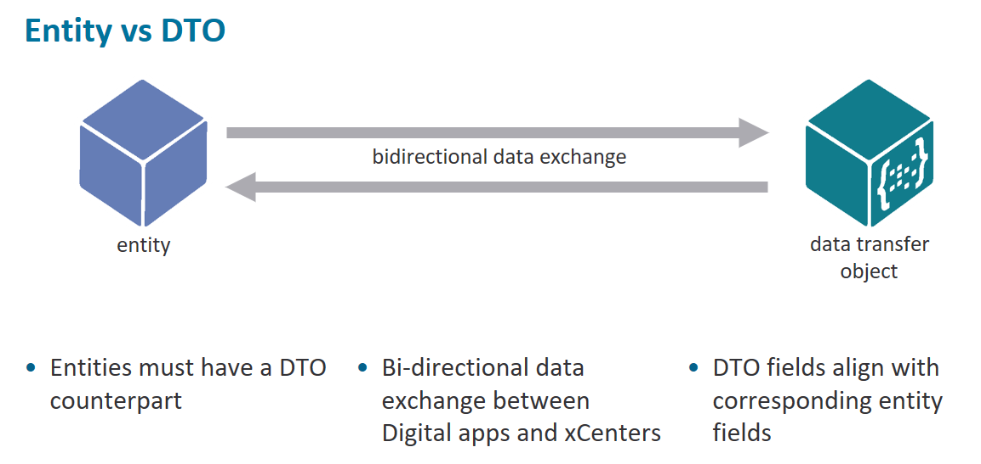
Notes:
InsuranceSuite entity data is exposed to the Digital frontend using a corresponding data transfer object class that facilitates data exchange.

Slide 11
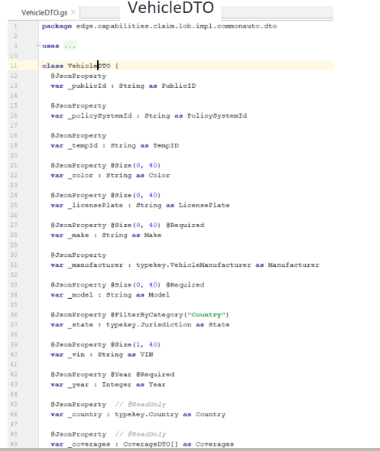
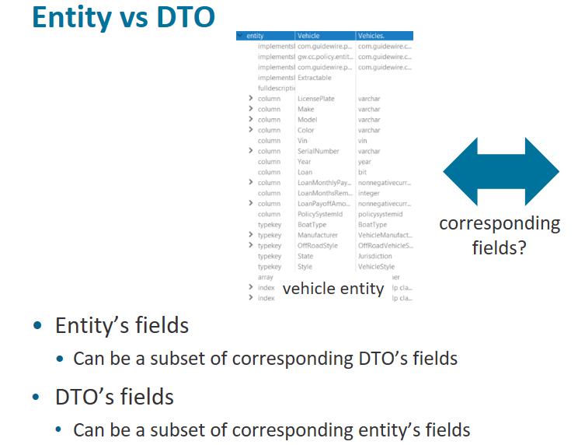
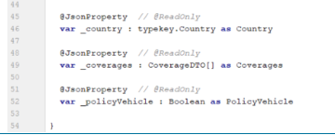
Notes:
However an entity is not always constrained to align its fields with those of a data transfer object class. Entity fields can be a subset of its DTO fields or the DTO fields
can be a subset of the entity instance’s fields, depending on business requirements for data to be available in Digital applications.
When a DTO is passed from a Digital app to an InsuranceSuite application, the DTO instance needs to be matched to a corresponding entity instance which determines if an entity instance is created, updated or deleted.
Notice that a data transfer object class has a publicID property which identifies the corresponding entity instance that will be modified.
Next, using an example, you will learn how InsuranceSuite entities are updated using DTOs.

Slide 12
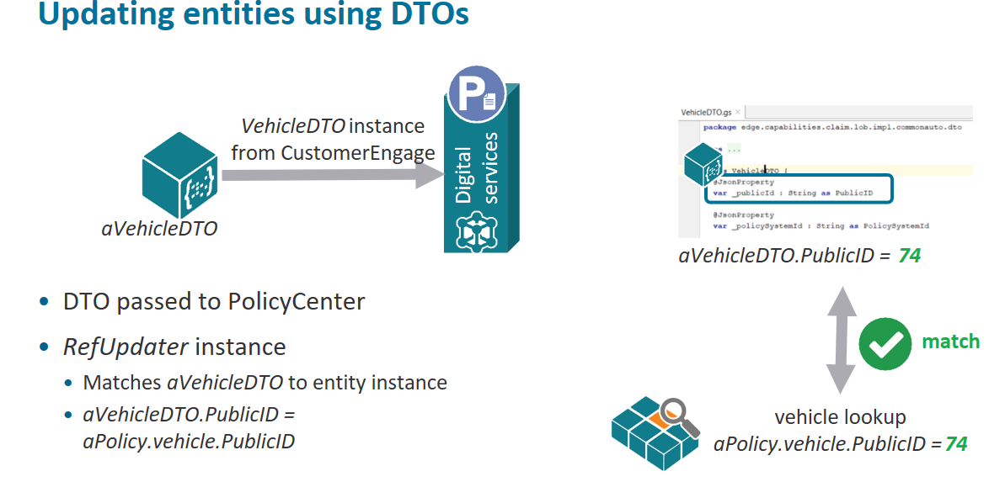
Notes:
When a DTO is passed from a Digital app (containing userprovided data from a Digital app) to an InsuranceSuite application, the DTO instance needs to be matched to a
corresponding entity instance which determines if an entity instance is created, updated or deleted. All DTO instances have publicID properties that identify the
corresponding entity instance that it wishes to update or delete.
Take this example, a VehicleDTO is passed from CustomerEngage-Account Management Entity updates are delegated to RefUpdater classes which match aVehicleDTO to its
corresponding entity instance.
In this example, you can see that aVehicleDTO.PublicID = aPolicy.vehicle.PublicID indicating a match.

Slide 13
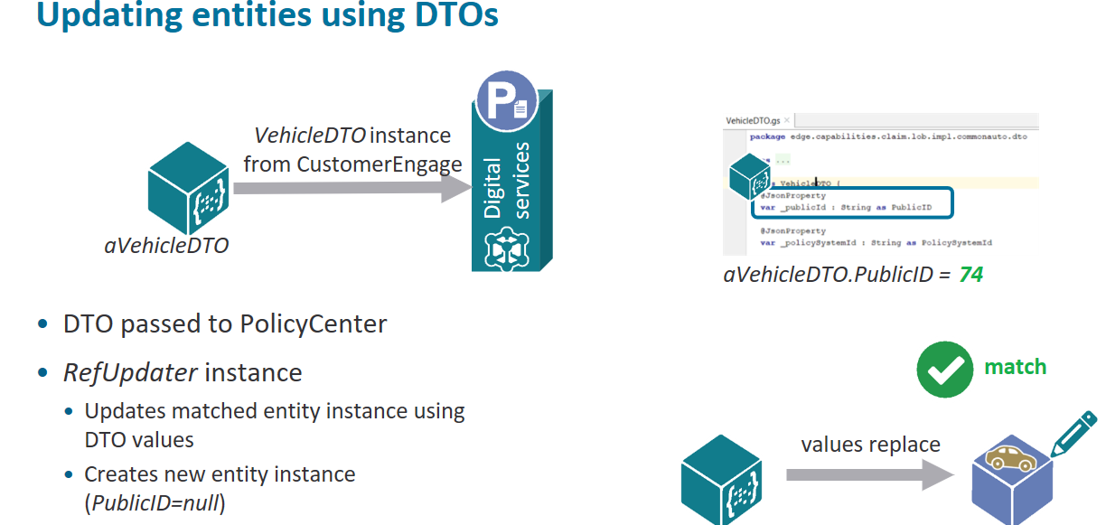
Notes:
When matched, the RefUpdater updates the entity (aPolicy.vehicle) with the contents of aVehicleDTO.
If a reference does not exist (PublicID=null), the RefUpdater creates a new vehicle entity instance.
Next, you will learn how JSONRPC requests are fulfilled.

Slide 14
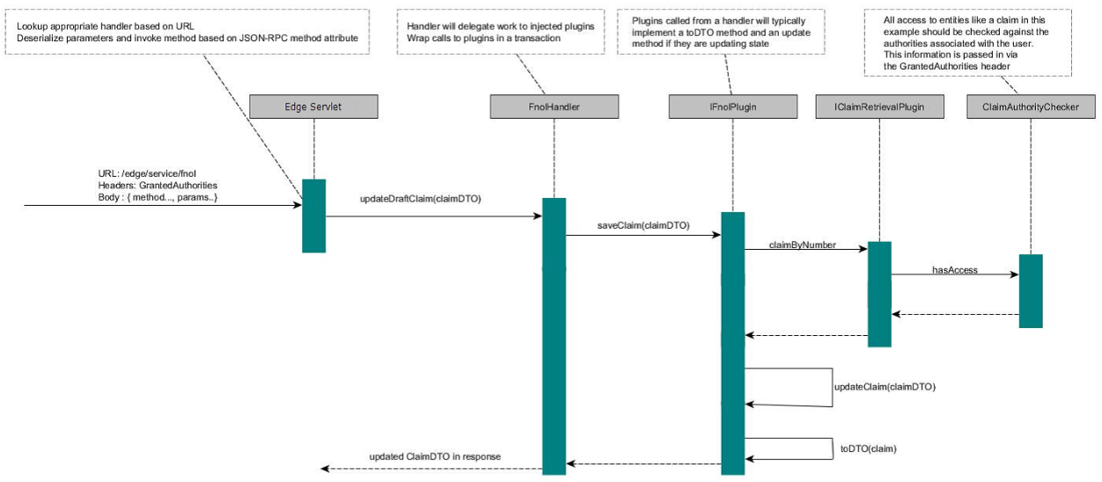
Notes:
The Digital services define the structure of the request and response using the JSON-RPC specification. HTTP is used as the transport protocol, with all calls being made by using POST requests.
The POST request first hits the JsonRpcServlet.doPost method, and from there the input parameters are deserialized and validated before the appropriate handler method is called.
The JSON body contains the name of the handler to call. Jackson is used as the underlying library for marshaling the DTO objects that are passed to the handler methods.
Successful responses from the handler are wrapped in the result property of the response object, and a successful status header is set on the HTTP response.

Slide 15
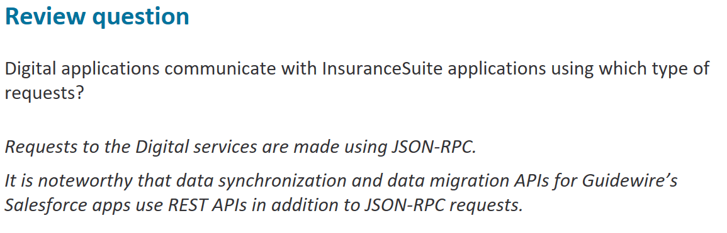

Slide 16
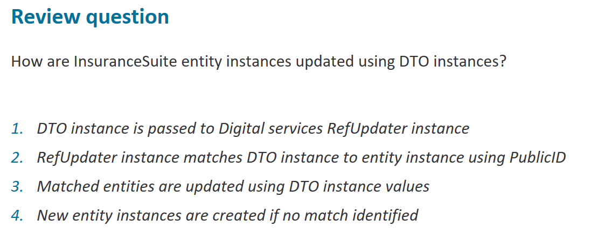

Slide 17
